Slide 1

EXPERT SYSTEM USING
BAYESIAN NEURAL NETWORKS
MTECH PROJECT PRESENTATION
GUIDE: Dr. Srinivas Padmanabhuni
S. BHARATH KUMAR
CS20M011

Slide 2
CONTENTS
ABSTRACT
INTRODUCTION
PROBLEM DEFINITION
BACKGROUND INFORMATION
MATERIALS AND METHODS
RESULTS AND DISCUSSIONS
SUMMARY AND CONCLUSION
REFERENCES

Slide 3
ABSTRACT

Slide 4
Abstract
An Expert System can be defined as a knowledge-base system that acquires knowledge from its knowledge base of a specific domain and addresses user queries using its inference engine about that specific domain.
In the Expert System, we have 3 main parts(Knowledge Base, Inference Engine, User Interface).
One of the important application is Predictive Maintenance where it helps in effective monitoring of the machinery and helps us to get quick repair solutions with its knowledge and improve its lifetime.
We are using Bayesian Neural Networks as a part of the inference engine of the expert system which helps to overcome the uncertainties from standard Neural Networks and gives confident and dynamic predictions.

Slide 5
INTRODUCTION

Slide 6
Introduction
Expert system:
It can be defined as a knowledge-based system where it acquires knowledge about a particular(specific and narrow) domain with the help of an expert from that domain and uses its inference engine(here it’s BNN and not rule-based ones) to address user queries.
Expert System = knowledge base + inference engine + UI(optional)

Slide 7
Bayesian Neural Network:
It is defined as a stochastic ANN trained using Bayesian inference. In simple terms, we use the probability of weights and biases and other parameters instead of singular values to the above terms.
BNN = Stochastic Neural Network + Bayesian Inference.
Stochastic Neural Network = ANN + stochastic components(using probability distribution p(θ))

Slide 8
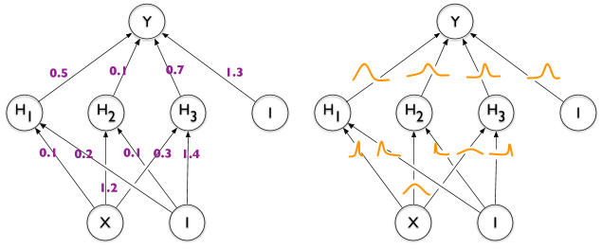
Unlike Standard Neural Networks (on left side) that have a fixed value for the parameters, Bayesian Neural Networks(on right side) has a distribution defined over them.
Source: The very basics of BNN link

Slide 9
Problem Definition
We are developing an Expert system for the domain of Predictive Maintenance by using Bayesian Neural Networks as a part of its inference engine.
Why use Bayesian Neural Networks when we can do it with standard Neural Networks ? It is because standard Neural Networks fit over the given data and becomes overconfident about their predictions. This causes them to be uncertain.
To overcome this, we are implementing Bayesian Neural Networks for developing an inference engine for our expert system.
These BNN’s predicts with certainty and are dynamic and confident over their predictions. They achieve it by using probabilities for weights and biases instead of only integers.

Slide 10
BACKGROUND INFORMATION

Slide 11
Background Information
Expert systems were built for various specific domains like fault diagnostics, automobile repairs, maintenance of machines etc using different tools and technologies like rule-based engines etc.
Some authors have implemented GUI for expert systems using languages like java and SQL for implementing database for their tools.
The inference engine part of the expert system was mostly implemented using IF.THEN rules(rule-based engines) which are manually written is not an efficient way to implement an expert system.

Slide 12
MATERIALS AND METHODS

Slide 13
Implementation
Dataset: AI4I 2020 Predictive Maintenance Dataset from UCI Repository (link here).
Google Colab Notebook: link here.
Pre-processing data. (Product Quality: L,M,H -> 1,2,0)
Training(70%) and testing data(30%).
Compile, train and evaluating the models.
Standard Neural Network (using tensorflow)
Bayesian Neural Network (using tensorflow-probability)

Slide 14
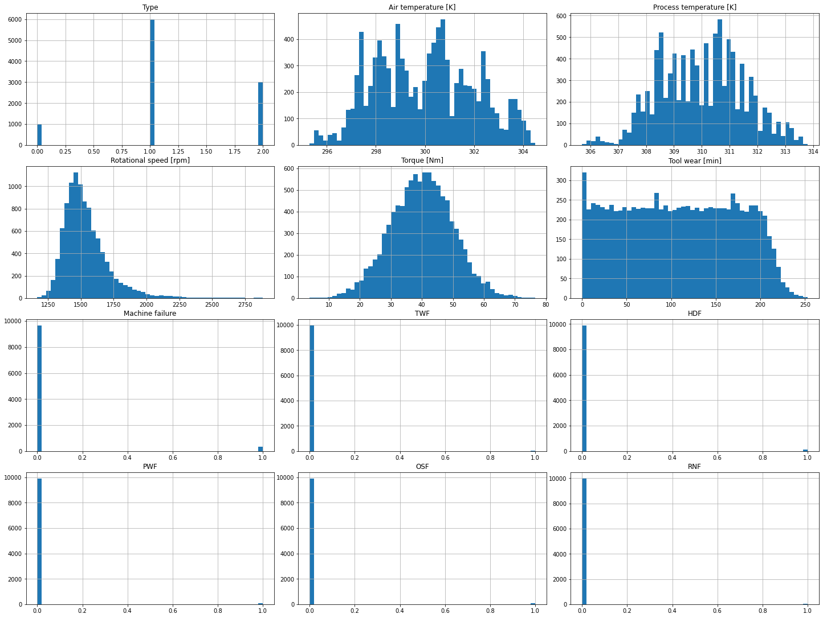

Slide 15
Standard Neural Network
Standard Neural Network: Implemented using tensorflow library by creating a neural network of 3 layers (Input, hidden and output layer).
No of epochs: 50
Learning rate: 0.001
Train accuracy: 0.9649
Training loss: 0.1522
Test accuracy: 0.9690
Test loss: 0.1385

Slide 16
Bayesian Neural Network (BNN)
Bayesian Neural Network (BNN): Implemented using tensorflow-probability library by creating a neural network of 3 layers (Input, hidden and output layer).
No of epochs: 50
Learning rate: 0.001
Training accuracy: 0.9690
Training loss: 0.4488
Test accuracy: 0.9686
Test loss: 0.4487

Slide 17
Tools and Methodologies
Tools and Technologies used: Streamlit, Tensorflow probability, Tensorflow, Google colab notebook, Github
The following were the steps taken in implementing all kinds of (Bayesian Neural
Networks) BNNs.
Defining a model.
Fitting the model onto the data.
Evaluating the model.
Plotting different parameters of the model for comparison.
Saving the model as a file for including it in the web application.
Saving the model architecture as an image.

Slide 18
All the BNN models with different versions are described below.
Variational Inference :
1. Normal BNN -1: 3 - layers, epochs = 25, learning rate = 1e-06
2. Normal BNN -2: 4 - layers, epochs = 15, learning rate = 1e-06
3. Normal BNN -1: 3 - layers, epochs = 40, learning rate = 1e-06
4. Normal BNN -2: 4 - layers, epochs = 40, learning rate = 1e-06
5. Normal BNN -1: 3 - layers, epochs = 50, learning rate = 1e-06
6. Normal BNN -2: 4 - layers, epochs = 50, learning rate = 1e-06
7. Model tfp v1: 3 - layers, epochs = 40, learning rate = 0.002
8. Model tfp v2: 3 - layers, epochs = 80, learning rate = 0.005

Slide 19
Monte Carlo - Dropout:
learning rate = 1e-06, epochs=40
1. Dropout 1 : dropout value = 0.2
2. Dropout 2 : dropout value = 0.35
3. Dropout 3 : dropout value = 0.5
Early Stopping:
learning rate = 0.005, epochs=50
1. Early Stop 1: patience = 3
2. Early Stop 2: patience = 4
3. Early Stop 3: patience = 2

Slide 20
RESULTS AND DISCUSSIONS

Slide 21
CONTENTS
Visualizing BNN
Variants of BNN
Variational Inference
Monte Carlo - Dropout
Early Stopping
Comparison of Different Models
Web Application for Expert System

Slide 22
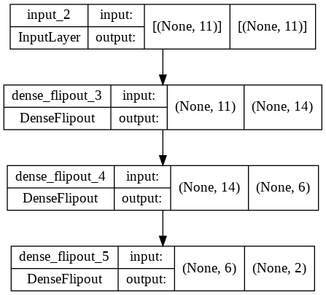
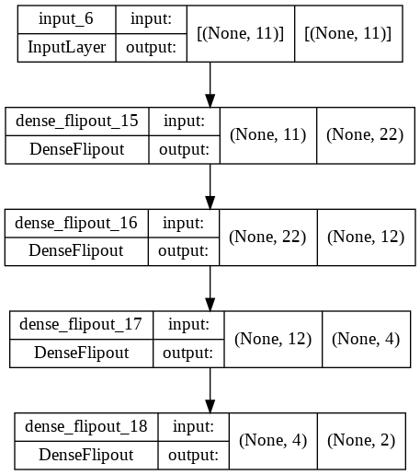
Visualize BNN

Slide 23
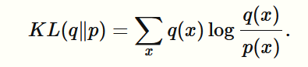
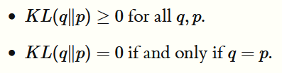
Variants of BNN
VI.(VARIATIONAL INFERENCE)
Variational Inference is also known as a posterior distribution over the latent variables and it can be defined as the conditional distribution over the latent variables given the observations and parameters.
This KL divergence function is used to measure differences in information contained within two distributions p and q. The KL divergence has the following properties that make it especially useful in our setting:

Slide 24
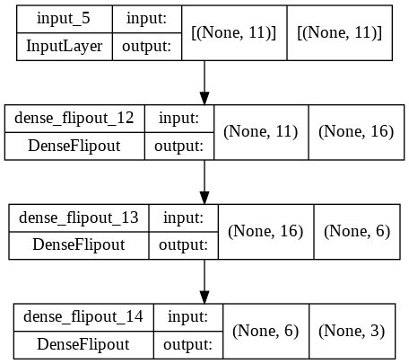
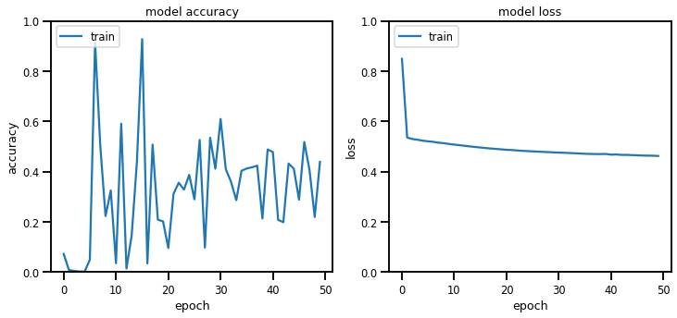
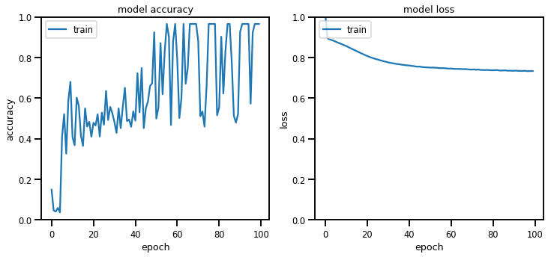

Slide 25
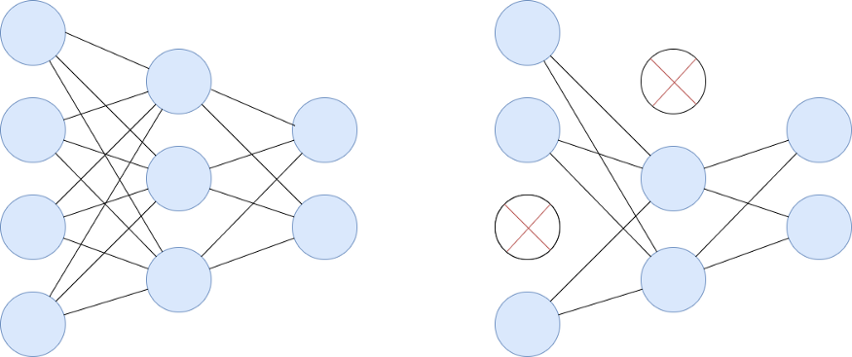
Variants of BNN
MC VIA DROPOUT
Monte Carlo Dropout is an improvement of the regular dropout (in which different neurons are dropped) technique which can be interpreted as a Bayesian approximation of a probabilistic model in which we consider many different neural networks as Monte-Carlo samples out of all models which are available. In most cases, it improves the performance of the model.
Parameter to be passed: Probability value which indicates the number of neurons to be dropped in the network.
Built three models:
Dropout 1 : dropout value = 0.2
Dropout 2 : dropout value = 0.35
Dropout 3 : dropout value = 0.5

Slide 26
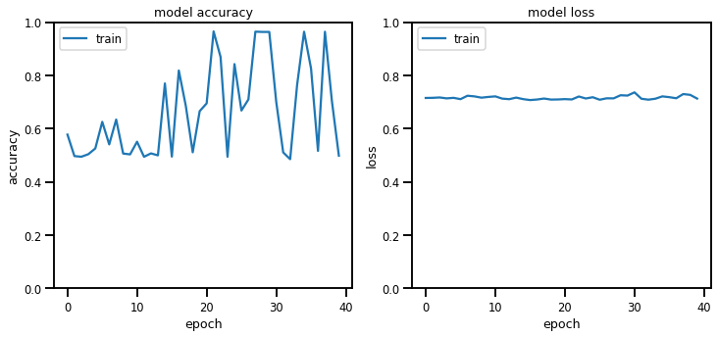
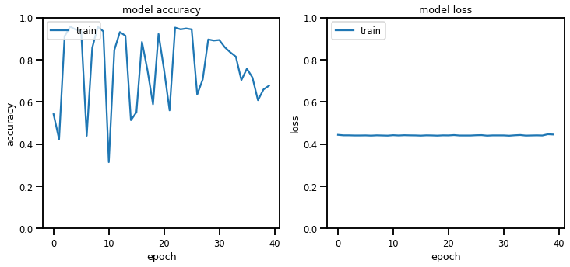
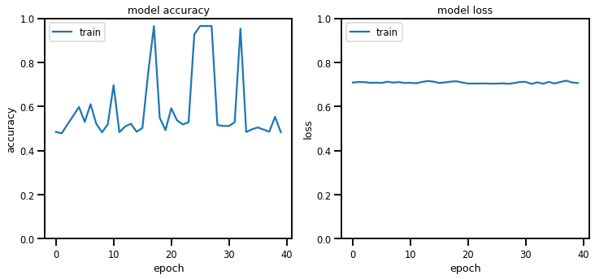
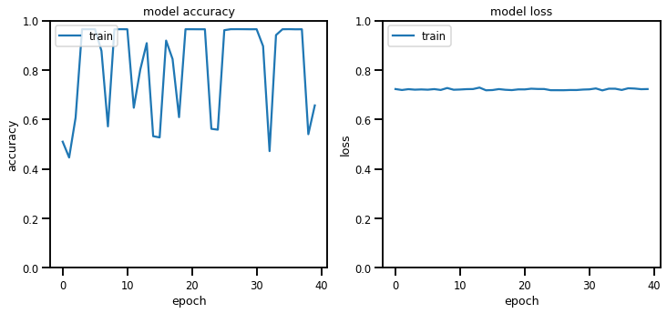
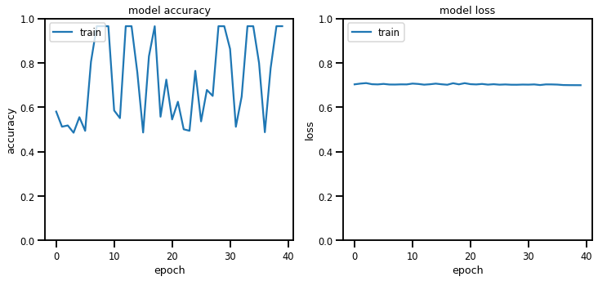
1. Normal BNN -1
2. Normal BNN -2
3. Dropout -1
4. Dropout -2
5. Dropout -3 3.
1.
4.
2. 5.

Slide 27
Variants of BNN
EARLY STOP
It can be defined as stopping the training of a neural network when a monitored value has not improved for a certain number of iterations. This usually improves the performance of the model.
patience: It is the limit on the number of epochs with no improvement. After reaching this count or limit, the training of the model will be stopped irrespective of the total epochs mentioned.
monitor: It describes the quantity(here it is loss which is being monitored.) which is to be monitored during the training of the model.
Built 3 models:
Early Stop 1: patience = 3
Early Stop 2: patience = 4
Early Stop 3: patience = 2

Slide 28
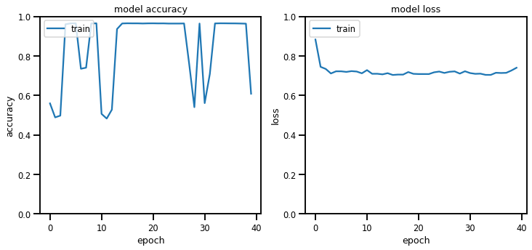
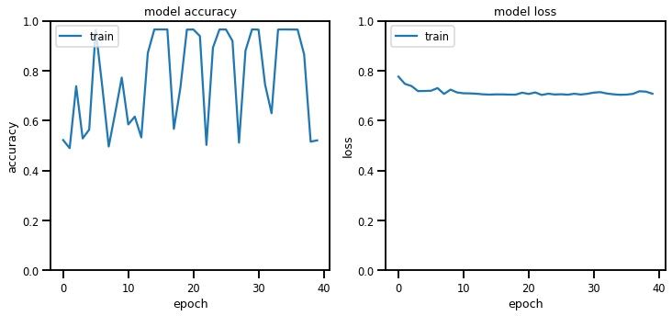
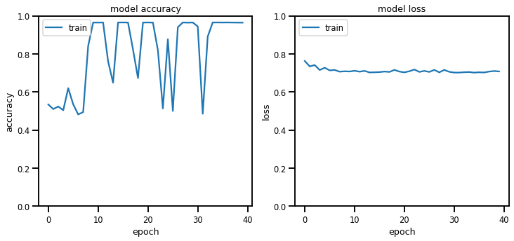
1. Normal BNN -1
2. Normal BNN -2
3. Early Stop -1
4. Early Stop -2 3.
5. Early Stop -3
1.
4.
2. 5.

Slide 29
Comparison of Different Models
Normal vs Dropout:
Normal BNN -1 : loss: 0.4377 - accuracy: 0.9687
Normal BNN -2 : loss: 0.7227 - accuracy: 0.9693
Dropout -1 : loss: 0.7029 - accuracy: 0.9690
Dropout -2 : loss: 0.7039 - accuracy: 0.0313
Dropout -3 : loss: 0.7060 - accuracy: 0.9687
Normal vs Early Stop:
Normal BNN -1 : loss: 0.4379 - accuracy: 0.9687
Normal BNN -2 : loss: 0.7183 - accuracy: 0.9690
Early Stop -1: loss: 0.7300 - accuracy: 0.9673
Early Stop -2: loss: 0.7086 - accuracy: 0.9680
Early Stop -3: loss: 0.7239 - accuracy: 0.9657

Slide 30
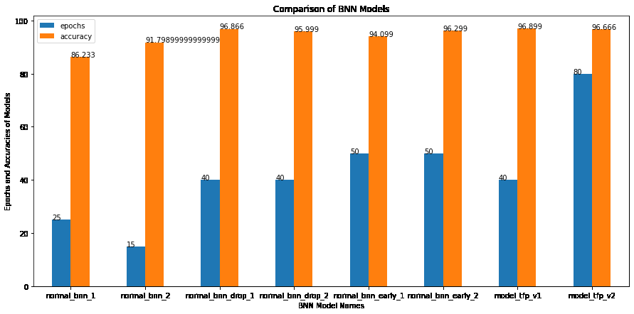
Comparison of BNN Models

Slide 31
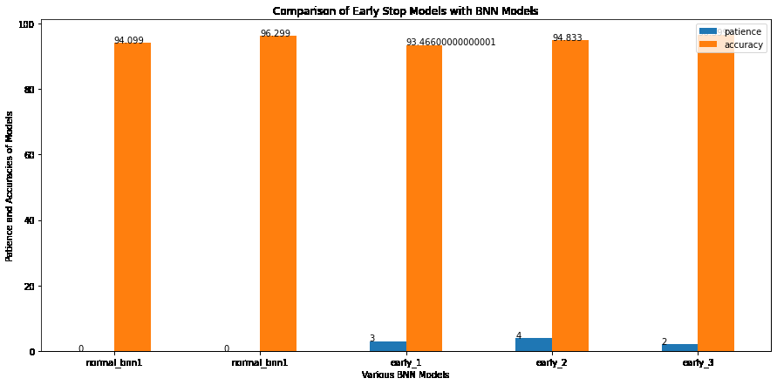
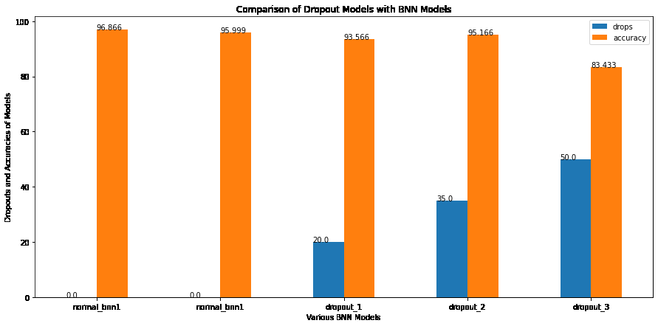
← Comparison of Early stop BNN models
Comparison of Dropout BNN models →

Slide 32
Streamlit based web application for Expert System - Screenshots

Slide 33
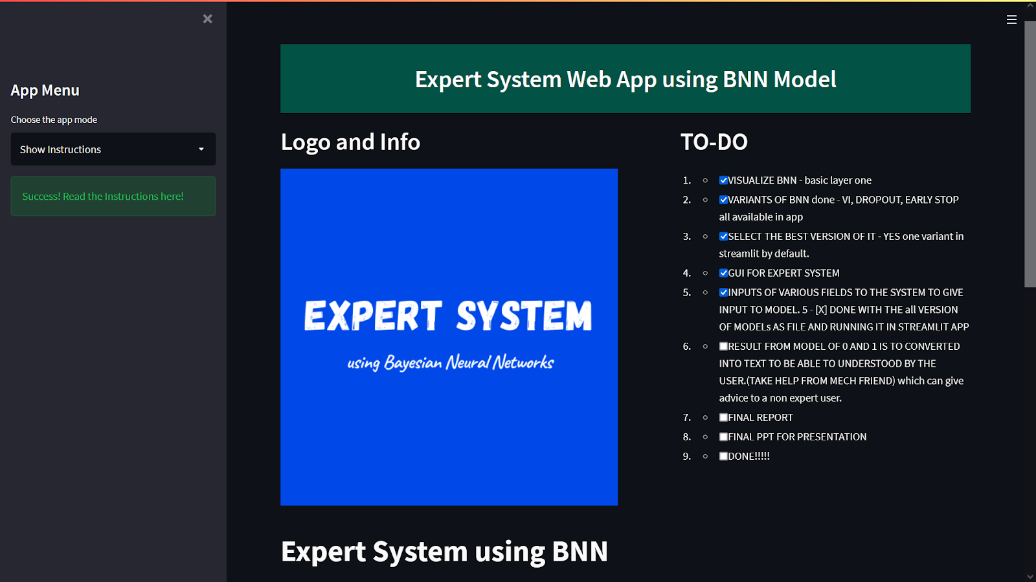
GUI for Expert System

Slide 34
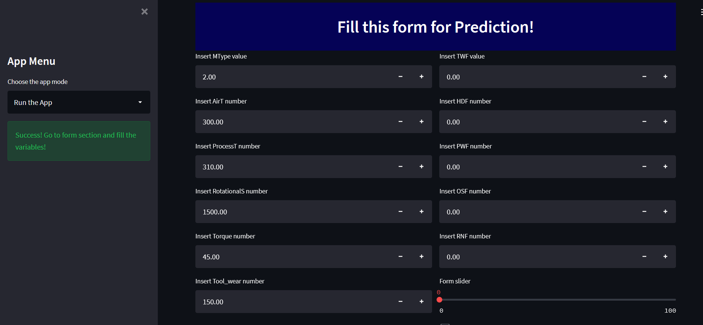
Prediction page

Slide 35
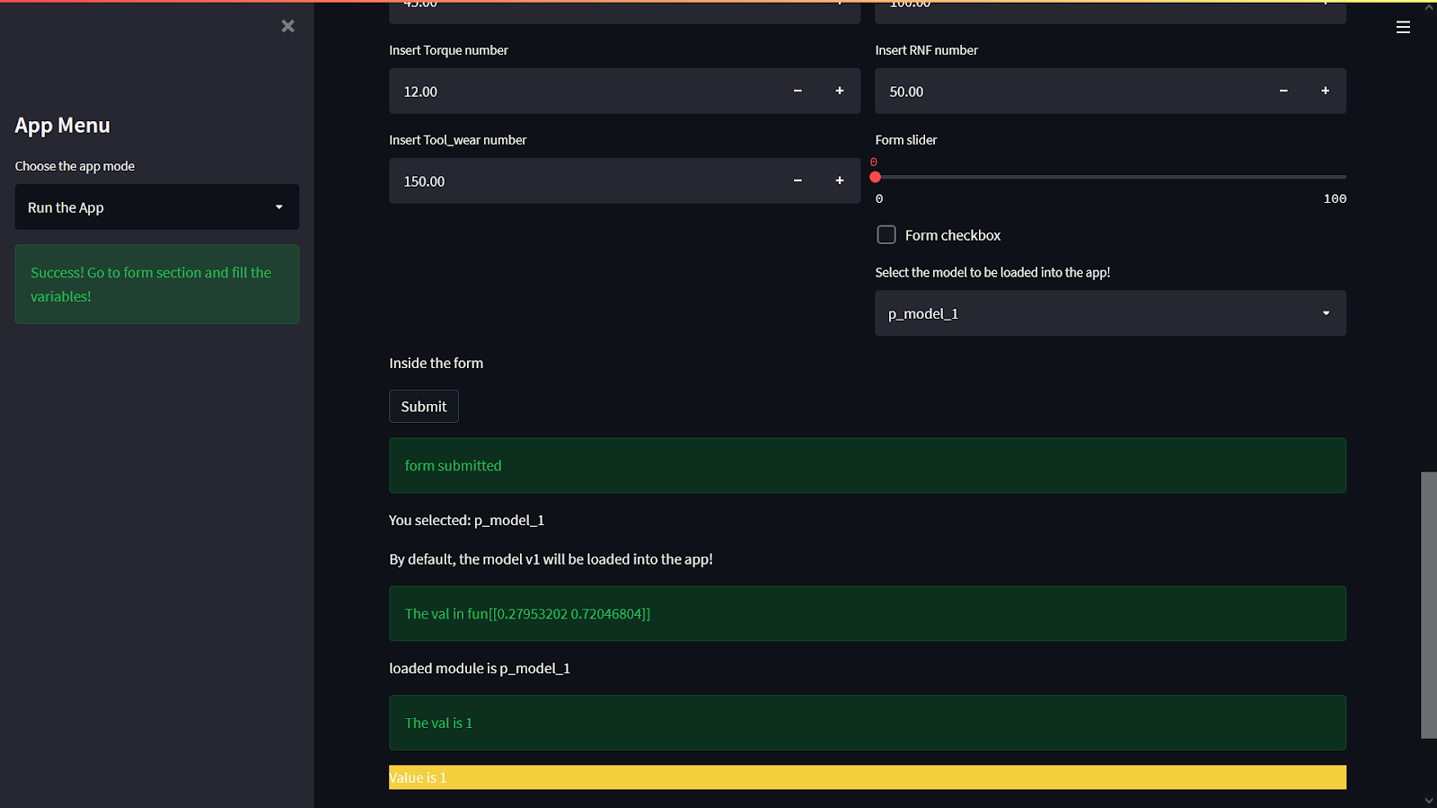
Prediction

Slide 36
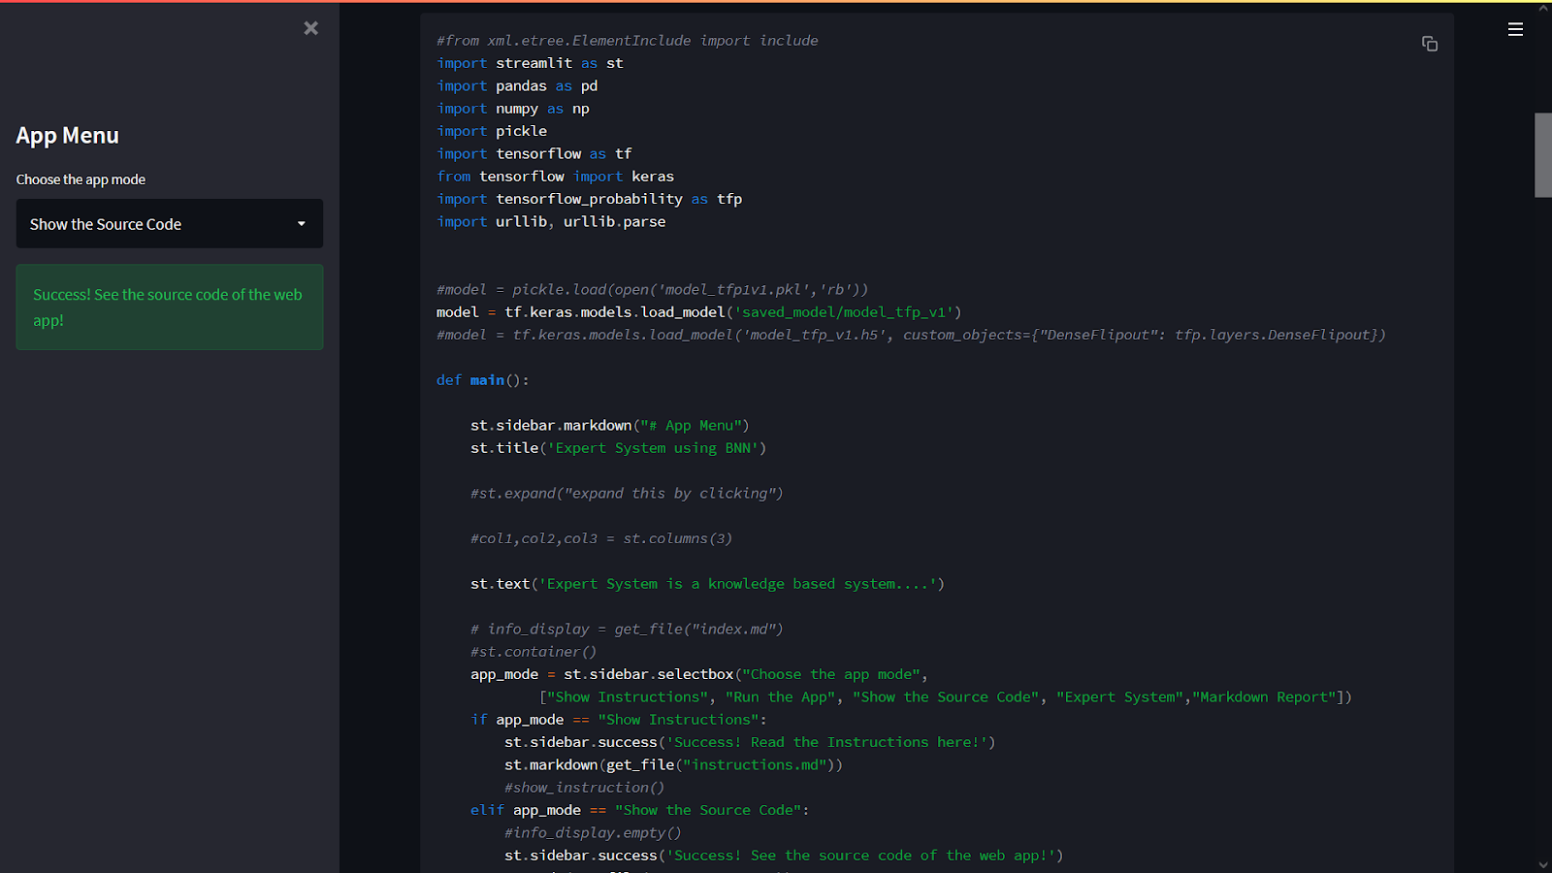
App displaying the source code of the application

Slide 37
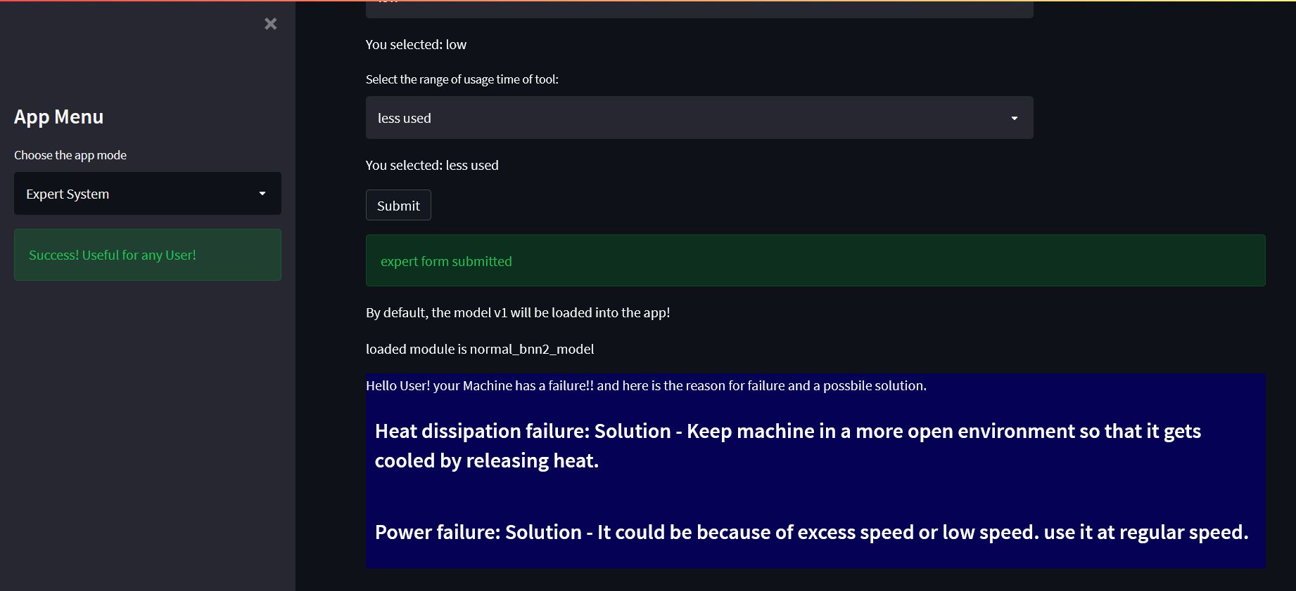
Expert system

Slide 38
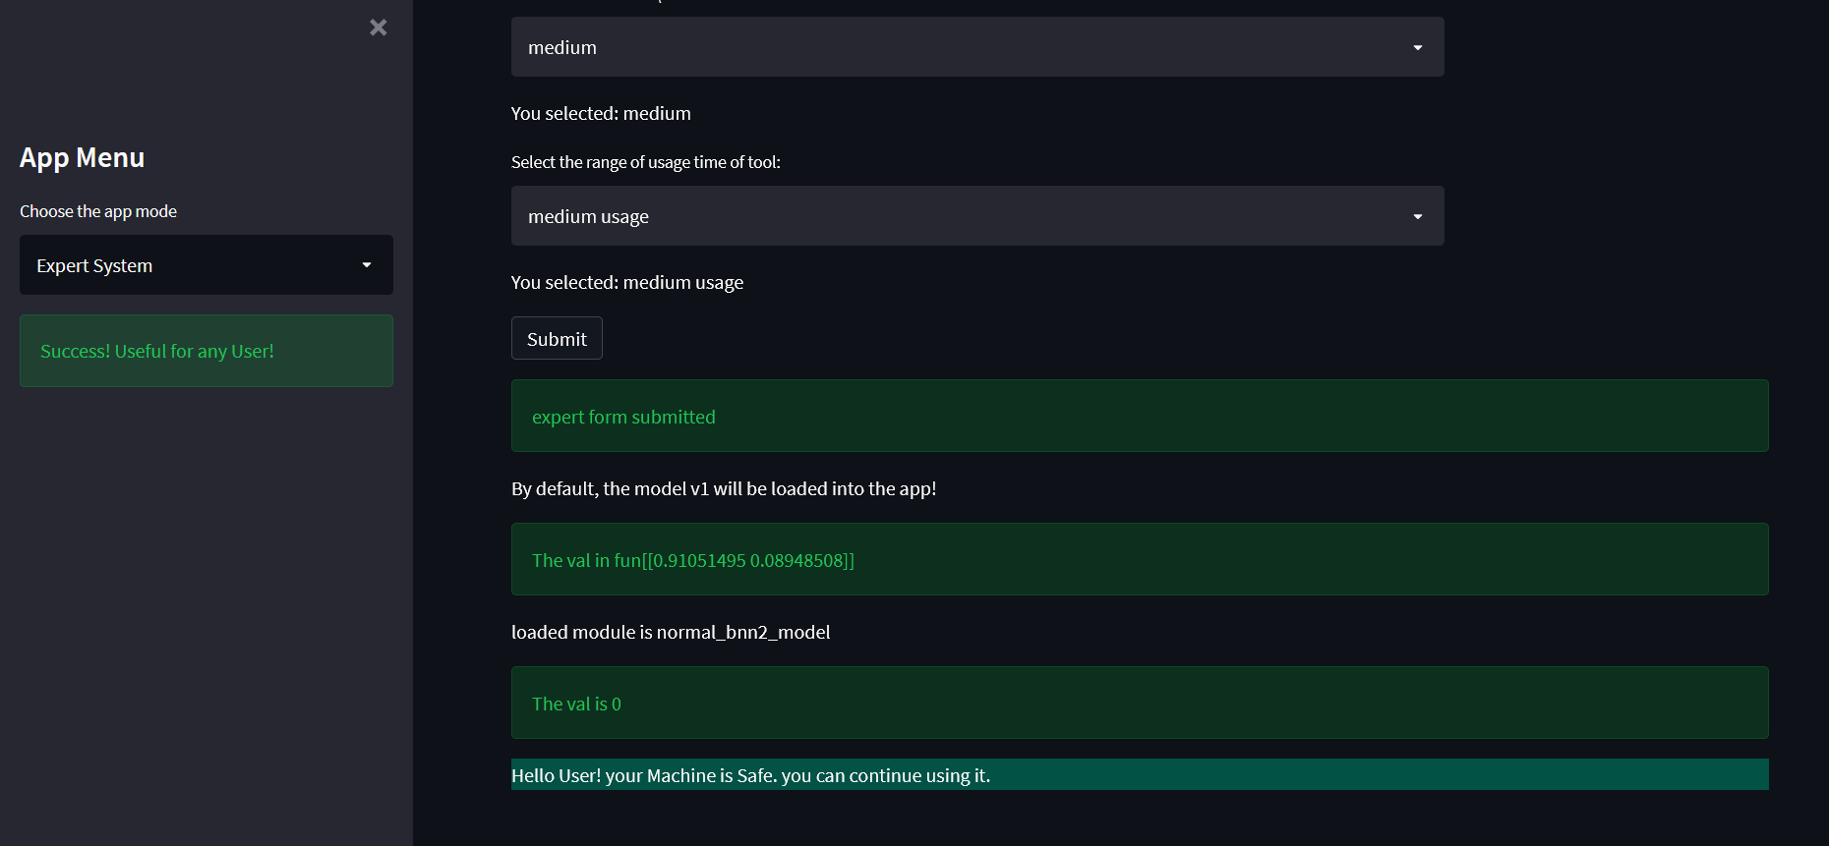
Expert system

Slide 39
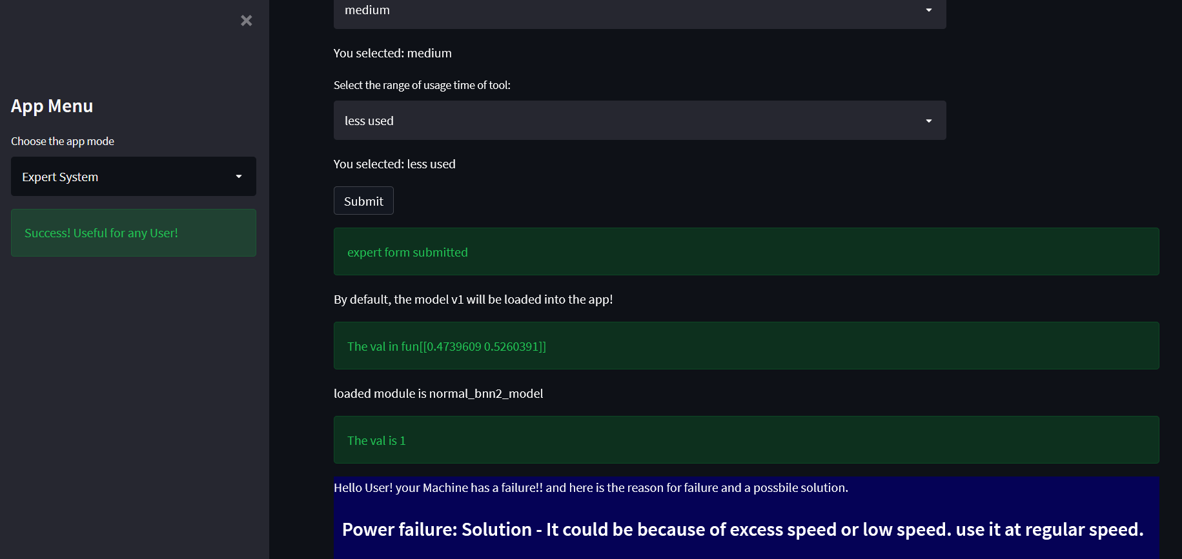
Expert system

Slide 40
SUMMARY AND CONCLUSION

Slide 41
Summary
Expert system using BNNs has many advantages compared to its limitations. So to overcome its limitations, we are using practical implementation techniques of Bayesian neural networks as a part of its inference engine which approximates them to give better results.
Some of the approaches implemented in this work are Variational Inference, MC Dropout, Early Stopping.
The dataset taken is for the task of Predictive Maintenance which helps in the identification of the most probable root cause of a problem or failure and to give a solution to rectify it.
This way, the frequency of maintenance can be reduced by having maintenance only when certain conditions are encountered and when it is necessary instead of scheduled maintenance which results in higher efficiency with low maintenance cost over long period of time.

Slide 42
Conclusion
From the comparison of the models built in implementing Expert System, we can observe that irrespective of their epochs and learning rates, all the models have very good accuracies ranging from 86% to 97% (approximately) and are giving good predictions.
In dropout BNN models, the model with dropout value as 0.35 (35%) is performing better and in Early stop models, the model with patience=2 is performing better.
Future scope: We can extend this work to make a generalised Expert Shell System where we can use this as a building block (template) or as an environment for developing any Expert System, just by changing the knowledge base for that specific system.

Slide 43
Links
Dataset: AI4I 2020 Predictive Maintenance Dataset from UCI Repository (link here).
Google Colab Notebook: link here.
Notebook Pdf: link here.
Github Repository: link here.
Web app demo link: video link here.
Report pdf link: link here.

Slide 44
References
Dataset: D. Dua and C. Graff, “UCI machine learning repository,” 2017. [Online].
Available: http://archive.ics.uci.edu/ml
L. V. Jospin, W. Buntine, F. Boussaid, H. Laga, and M. Bennamoun, “Hands-on bayesian neural networks – a tutorial for deep learning users,” 2020.
K. Bykov, M. M.-C. H¨ohne, A. Creosteanu, K.-R. M¨uller, F. Klauschen, S. Nakajima, and M. Kloft, “Explaining bayesian neural networks,” 2021.
D. T. Chang, “Bayesian neural networks: Essentials,” arXiv, 2021.
N. Hassen and I. Rish, “Approximate bayesian optimisation for neural networks,” arXiv, 2021

